Slide 1

Generational Diversity
Notes:
Today, we’re going to talk about generational diversity. Recognizing and understanding differences among the different generations in the workforce can help you better supervise your employees. Generational diversity can have an impact on the way employees perform, the way they perceive you and the organization, and the way they interact with one another.
Although generational differences are only one way the workforce is diverse, and although generation is only one factor affecting employees’ attitudes and behavior, you need to understand the influences, experiences, and concerns that shape your employees so that you can work well with employees of all ages and encourage them to perform at their best.

Slide 2

Session Objectives
  Define generational diversity
  Identify the different generations
  Understand differences among generations
  Appreciate the impact of generational diversity
  Use knowledge of generational diversity
  to improve supervision of all employees
Notes:
The main objective of this session is to help you better understand generational diversity so that you can supervise all your employees more effectively. By the time the session is over, you should be able to:
Define generational diversity;
Identify the different generations in the workforce;
Understand differences among the generations that can affect the workplace;
Appreciate the impact of generational diversity in communication, feedback, teamwork, motivation, training, and development; and
Use knowledge of generational diversity to improve supervision of all employees.

Slide 3
Diversity and the Workplace
  The workforce is diverse in many ways
  Generational diversity focuses on differences based on the generation in which an employee grew up
  A generation is about 20 years
  There are four generations in today’s workforce
Notes:
The workplace has always been a diverse place where different people of different ages, backgrounds, and abilities have come together to work and make things, provide services, and help our economy grow.
The workforce is diverse in many ways, including race, gender, cultural and religious background, educational and economic background, age, and ability.
Generational diversity focuses on differences among employees based on the generation in which a person grew up.
A generation has been defined as a period of roughly 20 years. So, for example, all people born between 1960 and 1980 would be of the same generation.
There are four generations in today’s workforce.
Can you identify the four generations in today’s workforce and give the approximate dates for each? For example, Baby Boomers were generally born between 1945 and 1960.

Slide 4
The Generations
Matures
born before 1945
Baby Boomers
born 1945-1960
Generation Xers
born 1961-1980
Millennials
born 1981-2000
Notes:
The four generations in today’s workforce have been called different things and the exact dates of their generation vary from report to report. However, the names and dates you see on the screen will help us identify the different groups and their approximate ages, which is all we really need to be concerned about.
The Matures, also known as Traditionalists, were born before 1945. There are few of them left in the workplace and the numbers are decreasing annually. But there are still some people who will work full or part time, or come back to work part time or as temps after retiring, so you need to be aware of this group and the generational issues associated with them.
The largest generational group in the workplace today is the Baby Boomers, born after World War II and on into the early 1960s.
The next largest group—the Generation Xers born in the mid-1960s to 1980.
The final group is the Millennials, also known as Generation Y. These workers were born in the 1980s and 1990s.

Slide 5

Caution
Generation is only one factor
Some people have more in common
with the next generation
Avoid stereotyping employees
Notes:
Before we proceed, it’s important to give a word of caution concerning generational diversity.
Generation is only one factor affecting an individual. Other factors such as family background and personal experiences, interests, aspirations, abilities, and personality traits may be more important.
Furthermore, the line between one generation and the next is not a clear one. Generations are approximations. People born at the end of one generation may have more in common with the next generation than their own.
So be careful to avoid stereotyping or pigeon-holing employees because of their generation. Generational diversity is only one of many factors you need to consider when supervising employees.

Slide 6

Formative Influences: Matures
Radio
Depression and New Deal
World War II
Korean War
Depression
and New Deal
Korean War
World War II
Radio
Notes:
To understand the differences among the generations in the workforce, it’s important to look at the influences and experiences that shaped their formative years.
These are people who came of age in the late 1930s and early 1940s. They were a generation that grew up on radio rather than TV.
They lived through the Depression and New Deal, or at least felt the effects of those times and heard about the hardships from parents and grandparents—something they would never forget.
These workers were also shaped by World War II, a war in which many of them fought and were injured.
The younger Matures may have fought in the Korean War, or most likely their fathers did.

Slide 7

Formative Influences: Boomers
Television
Cold War and nuclear weapons
Civil rights
Kennedy and King assassinations
Vietnam War
Sexual revolution, music
and drug culture
Space travel and
environmental concerns
Sexual revolution,
music and drug
culture
Space travel and
environmental
concerns
Kennedy and King
assassinations
Cold War and
nuclear weapons
Vietnam War
Television
Civil rights
Notes:
The Baby Boomers were the TV generation. Most of them grew up with “Howdy Doody,” “Gunsmoke,” “I Love Lucy,” and all the other shows of the fifties.
They also grew up during the Cold War and lived under the threat of nuclear annihilation.
The civil rights movement of the 1950s and 1960s was also a powerful influence for this generation.
Other influences were the assassinations of President Kennedy, Martin Luther King, and Senator Robert Kennedy.
Perhaps one of the biggest influences was the Vietnam War and the protest movement that grew up as a result.
This generation also experienced the effects of the Beatles and Rolling Stones, Woodstock, the sexual revolution, and the drug culture in the late sixties when many of them were coming of age in their late teens and early twenties.
And, of course, many of them watched the TV footage of the early astronauts circling the earth in their spacecrafts and walking on the moon in July 1969. Boomers were also influenced by concerns about planet earth. The new environmental movement was largely made up of Boomers at first.

Slide 8
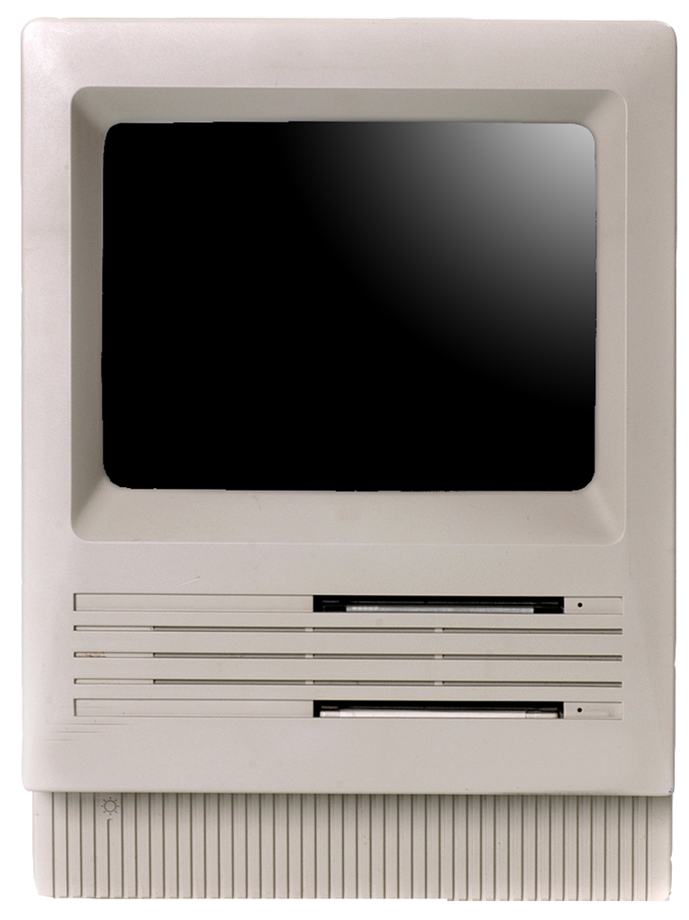
Formative Influences: Xers
Computers
Women’s liberation
Watergate, end of Vietnam
War, and energy crisis
Hostages in Iran, war and
peace in the Middle East
Reagan era
Yuppies and the age of excess
Computers
Women’s liberation
Watergate, end of Vietnam
War, and energy crisis
Hostages in Iran, war and
peace in the Middle East
Reagan era
Yuppies and the age of excess
Watergate, end of Vietnam
War, and energy crisis
Hostages in Iran, war and
peace in the Middle East
Yuppies and the age of excess
Women’s liberation
Computers
Reagan era
Notes:
The Generation Xers were the first computer generation, and by the time they got to the workplace the technology boom was just beginning. Xers were influenced by many other goings-on in their formative years.
For example, women’s liberation was becoming an issue in the late sixties and really taking off in the seventies when many women liberated themselves from the home and entered the workplace in numbers unprecedented since World War II.
Watergate, the winding down of the Vietnam War, and the energy crisis were the big issues in the seventies.
And, in the late seventies, the big issue was the hostages in Iran—an incident that fore- shadowed the terrorism of our times. And the Middle East was at war in the early years of the seventies, but by the Carter era in the late seventies, Egypt and Israel were meeting with President Carter at Camp David to talk peace.
The Reagan era in the eighties was a major influence on many Xers. The “Evil Empire” of the Soviet Union, covert wars in Central America, and high inflation at home were key issues of the time.
And, of course, while the Boomers had their Woodstock and hippies, the eighties ushered in the Yuppies and “Lifestyles of the Rich and Famous.”

Slide 9

Formative Influences: Millennials
Internet, cell phones, computers at home
Iraq wars and other military actions
Fall of Communism in Europe and removal of Berlin Wall
Terrorism (Oklahoma City and 9/11)
School shootings
Economic prosperity at home in the 90s and early 2000s
Internet,
cell phones,
computers at home
Iraq wars and other
military actions
Fall of communism
in Europe
and removal of
Berlin Wall
Economic prosperity
at home in the 90s
and early 2000s
Terrorism—
Oklahoma City
and 9/11
School shootings
© BLR®—Business & Legal Resources 1501
Notes:
The Millennials were the first true Internet generation. And the technology boom also included cell phones and computers at school and in nearly every middle class home.
The Millennials have also been affected by war—first the Gulf War and then the Iraq War. As young teens, Millennials also watched military actions involving the U.S. in Ethiopia—unsuccessful—and Kosovo—successful.
Millennials were also influenced by the dramatic fall of Communism in Europe and watched as young Germans tore down the Berlin Wall.
They also watched the horrific scenes of terrorism on TV—first the Oklahoma City bombing and then 9/11. And they saw video of the first school shootings by and of members of their own generation.
This generation also grew into their teens and early twenties in a time of economic prosperity. The stock market was booming in the nineties and just about everybody who wanted to work or could work could find a job—even teens could get a job easily in the service sector.
Can you think of any other formative influences for any of the generations?

Slide 10

Attributes and Attitudes: Matures
Work ethic, loyalty, and dedication
Responsibility, duty, and sacrifice
Respect for authority and rules
Willing to “pay their dues” to get ahead
Job for life
Notes:
Now let’s take a quick look at the values and attitudes of the different generations, beginning with the Matures.
These workers were brought up either in hard times or with parental memories of hard times. For the most part, this influenced them to believe in the work ethic, loyalty, and dedication to their employer.
They tend to focus on responsibility, duty, and sacrifice in terms of their employment and their families.
These employees have respect for authority and rules.
And they’ve been willing to “pay their dues” over the years, put in the hours and do the hard work to get promotions and raises. They never expected to be given a free lunch or a free ride.
They did, for the most part, however, expect to keep their job for life if they chose to. Many of this generation were solid union supporters who believed in seniority rights, the power of the union to protect their jobs, and the gratitude of their employer for their loyalty, dedication, and hard work.

Slide 11


Attributes and Attitudes: Boomers
Rights
Believing in
change and possibilities
Career and
personal growth
Self-gratification
and self-interest
Teamwork and participation
Notes:
The Baby Boomers, on the other hand, grew up in a time when rights were a big issue—in schools, voting booths, housing, and workplaces. They came to work with the notion that they had rights as employees and employers had to respect their rights.
Boomers also brought with them the optimism of the sixties and the belief that change could and should occur, and that at work as everywhere else in their lives, there were lots of possibilities within their grasp.
This generation has been more interested in career and personal growth than the previous generation.
They have also tended to value self-gratification and self-interest more than loyalty and dedication to the organization.
However, Boomers, for the most part, have been big on teamwork and participation. And when they moved into positions of power in the workplace, they put an emphasis on these strategies, which have been widely adopted and have proved very successful in American enterprises of all kinds.

Slide 12

Attributes and Attitudes: Xers
Independence, self-reliance
Pragmatism
Growth oriented
Comfortable with technology
Need challenges
Value flexibility
Notes:
Generation Xers tend to be independent and self-reliant, and may consider rules as guidelines rather than absolutes.
They are also pragmatic rather than dogmatic. They use what works and work with what they have at hand.
Xers are also growth oriented and interested in career advancement.
They’re comfortable with technology and keep up to date on workplace changes.
Many of them need challenges to keep them interested and performing at their best.
And, they value flexibility in their jobs.

Slide 13

Attributes and Attitudes: Millennials
Confidence
Optimism
Wired to technology
Multitaskers
Respectful of
diversity
© BLR®—Business & Legal Resources 1501
Notes:
The Millennials are still fairly new to the workplace, so it’s hard to be definitive at this point about their values and attitudes. But for the most part they appear to be:
Confident;
Optimistic;
Wired to every kind of technology;
Multitaskers; and
Respectful of diversity.
Can you think of other attributes and attitudes associated with members of the different generations?

Slide 14





Current Concerns: Matures
Keep working as long as possible
Retirement
Healthcare benefits
Remaining active
after retirement
Earning extra money after retirement
Notes:
The current concerns of the generations vary from individual to individual, of course. Some Matures, for example, may be concerned about continuing to work as long as possible—either for financial reasons or because work is an important part of their lives and the prospect of retirement is not such a pleasant one.
Others, on the other hand, may be looking forward to and planning for retirement right now. Their minds are already on the golf course or on spending more time with the grandchildren.
Most Matures, however, will be concerned about healthcare benefits—at least until they qualify for Medicare.
Some might be concerned about remaining active after retirement. They may be interested in coming back to work part-time or on a consulting basis.
And some might be interested in earning extra money after retirement by working at least part-time or on a temporary basis.

Slide 15





Current Concerns: Boomers
Healthcare benefits
Saving for retirement
Keeping up with workplace changes
Maintaining status
and position
Enjoying more
leisure time
Notes:
Baby Boomers are also interested in healthcare benefits. Statistics show that people in their fifties and sixties begin to experience more health problems and disease.
Boomers are generally also concerned about retirement. Some of the older ones are already retiring. The younger ones are busy saving for retirement. Many of them are empty nesters. They’ve finally gotten their kids through college and now it’s time to pump up the 401(k).
Baby Boomers may also be concerned about keeping up with workplace changes and new technologies. Some may find this more difficult than it is for the younger generations.
Boomers are also often concerned about maintaining their status and position as they face more and more competition from the up and coming Generation Xers.
And finally, many Boomers are also concerned about having more leisure time. They’ve been working for a long time and many have put in long hours on the job over the years. Now they want a little more free time to enjoy themselves.

Slide 16


Current Concerns: Xers
Advancement and raises
Achievement
and recognition
Job security
Healthcare benefits for children and spouse
© BLR®—Business & Legal Resources 1501
Notes:
Generation Xers are concerned about advancement and raises.
They also care about achievement and recognition for their achievements.
They want their job to be challenging, but they also want job security so that they can continue to provide for their families. With children headed for college, a big mortgage, and lots of other expenses, they can’t afford to lose their job.
And they also need their healthcare benefits, not so much for themselves perhaps, but for their children certainly and maybe also for their spouse.

Slide 17

Current Concerns: Millennials
Learning about
the job and the organization
Raises
Career opportunities
Recognition
Respect
Notes:
Members of the youngest generation are most concerned about learning. They need to learn all about their jobs and the organization.
Millennials are concerned about money and, therefore, raises are likely to be a big issue with them.
But they are also concerned about career opportunities, naturally, being at the beginning of their careers and beginning to think about the next step.
Millennials are generally also concerned with recognition and feed-back from their supervisors.
And, being respected is also very important to them.
Can you think of some other current concerns for any of the generations?

Slide 18
Who’s Who in the Generations: Match Game
Matures
1981-2000
1981-2000
Baby Boomers
Pre-1945
Pre-1945
Generation Xers
1945-1960
1945-1960
Millennials
1961-1980
1961-1980
Notes:
Let’s see now if you can match the generations to their approximate dates in the left-hand column. You can begin now.
Let’s review quickly.
Matures were born before 1945.
Baby Boomers were born between 1945 and 1960.
Generation Xers were born between 1961 and 1980.
And Millennials were born between 1981 and 2000.
How did you do? Did you get all the matches right?
Remember, these dates are just approximations. There’s some overlap between the generations, and people whose birth dates may put them in one generation might actually exhibit more traits of another generation.

Slide 19

Who’s Who in the Generations
Do you understand:
What generational
diversity is about?
Generational divisions in today’s workplace?
Formative influences
of each generation?
Attributes and attitudes
of the generations?
Concerns of different generations in the workforce?
Notes:
Now it’s time to ask yourself if you understand the information about generational diversity presented so far. Do you understand:
What generational diversity is all about?
Generational divisions in today’s workplace?
Formative influences of each generation?
Attributes and attitudes of the generations?
Current concerns of different generations in the workforce?
It’s important for you to understand all this information. It can help you recognize differences among the generations of employees who work for you and help you supervise all your employees more effectively.
Let’s continue to the next slide now and talk about age discrimination and generational diversity.

Slide 20

Age Discrimination and Generational Diversity
Illegal to discriminate against employees
40 or older
Older employees have the same rights as younger workers
Avoid marginalizing or making assumptions
Make employment decisions objectively
Notes:
The Age Discrimination in Employment Act makes it illegal to discriminate against employees age 40 or older in the terms and conditions of employment.
This means essentially that older employees have the right to the same employment opportunities as their younger co-workers. This includes the opportunity to compete for promotions, to receive job training, to be given meaningful performance appraisals, and so on.
Avoid marginalizing older workers or making assumptions about their aspirations and abilities. Don’t, for example, assume that older workers are less flexible or less willing to learn new skills and adapt to workplace changes.
And finally, to avoid even the appearance of age discrimination, always base all employment decisions on objective, job-related criteria.
Think about the requirements of our age discrimination policy.

Slide 21

Communication
Communicate with all employees regularly
Understand generational differences
Use language and references you know
Listen carefully
Help employees communicate with one another
© BLR®—Business & Legal Resources 1501
Notes:
Communication with and among employees is one of the most important issues any supervisor has to manage. Generational diversity introduces some extra considerations. For example, make sure you communicate with all your employees regularly. That means from the youngest to the oldest and everybody in between.
Make an effort to understand generational differences to make your interactions with employees more effective. By recognizing and accounting for possible generational differences, you can target your communications more accurately and successfully.
At the same time, use language and references you’re comfortable with and that anyone can understand and relate to when communicating to all your employees. In other words, be yourself but be aware of your own generational influences so that they don’t negatively impact your interactions with employees.
Always listen carefully to ensure mutual understanding with any employee of any generation. Clarify your understanding and ask questions if you don’t understand others’ words or meanings.
Also, take steps to ensure that workers communicate effectively with one another, regardless of generational differences.

Slide 22


Feedback
“I need lots and right away”
“What did you expect?”
How am I doing?”
“A couple of times a year’s good”
© BLR®—Business & Legal Resources 1501
Notes:
Generational differences also have an impact on feedback. For example, views about feedback among employees from different generations can be quite different. Although all employees need positive and corrective feedback from you regardless of their age, you should be aware of possible differences.
Matures may not rely much on feedback to perform well. They grew up in a time when hard work was expected and nobody gave you a pat on the back just for doing your job. So they may not need or expect as much feedback from you as the other generations. That’s not to say, of course, that they don’t need any feedback—because they do, even if it doesn’t get a big rise out of them.
Boomers may figure that they get most of the feedback they need from you during performance appraisals. In between, they’re happy to get along on their own and appraise their own performance.
Xers generally need to know how they’re doing. They want your feedback often and they want to know all the specifics—positive or negative.
Finally, Millennials grew up hearing their parents and teachers tell them “good job” every time they did something right. They also grew up in an age of instant communication. So they want lots of feedback from you and they want it right now.

Slide 23
Costs of Communication Failures
  Morale problems and conflict
  Higher turnover
  Increased recruitment, hiring, and
  training costs
  More complaints and grievances
  More disciplinary problems
Notes:
The cost of communication failures related to generational diversity is high. For example, failure to maintain efficient communication with and among employees of all ages and failure to provide sufficient and efficient feedback can lead to:
Morale problems and conflict;
Higher turnover;
Increased recruitment, hiring, and training costs;
More complaints and grievances; and
More disciplinary problems.
Think about the importance of positive feedback and the importance of good communication with and among employees of all generations. Can you think of any other costs of communication failure?

Slide 24

Teamwork
Reflect generational diversity in work teams
Teach team members to value differences
Support and encourage work relationships
Teach conflict resolution methods
Notes:
Another important issue associated with generational diversity is teamwork. Try to ensure that work teams reflect generational diversity to get a diversity of views and experience.
Encourage team members to value one another’s differences. Help them recognize the strength provided by their combined talents and perspectives.
Support and encourage work relationships among workers from different generations. This may involve team relationships, mentoring relationships, or simply cooperation and respect
between two employees who have to work together every day.
And finally, don’t forget to do something about conflict. Conflicts between and among generations are not unlikely, so it’s best to be prepared. Teach employees conflict resolution methods, and be ready to step in and mediate disputes if necessary.
Think about your work teams and the potential impact of generational diversity on team success.

Slide 25

Motivation
Employees respond to different motivators
Maintain high standards for all workers
Recognize and reward achievement
Provide opportunities
for all
Emphasize
performance goals
Notes:
Motivational strategies for employees from different generations depend on understanding their needs, concerns, and goals.
You must recognize that different employees respond to different motivators. One size rarely fits all. Generational diversity is one of the factors that can affect the motivators you use. For example, Boomers may be motivated by participation, while Xers are motivated by challenges and Millennials are motivated by instant feedback.
It’s also important when motivating a diverse group of employees to hold all of them to high standards of performance. When you expect everyone to perform at their highest level, not just your best employees, then you’re likely to motivate the best performance from all your employees.
Recognizing and awarding achievement is a universal motivator for all the generations. Everyone wants and needs recognition for effort and success.
To motivate all employees you also need to provide opportunities for all those who want them, not just for a chosen few.
And, to get the best performance from workers of all ages, you must emphasize performance goals and help employees reach their goals.

Slide 26
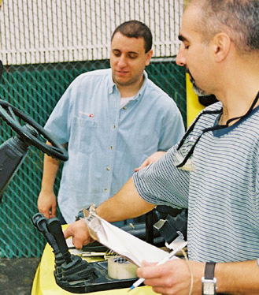
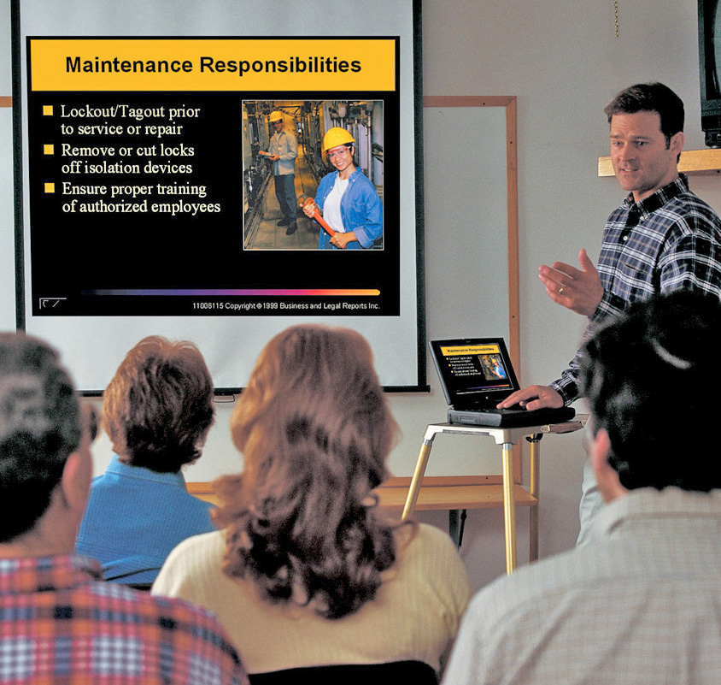
Training and Development
Assess group and individual training needs
Be sure all employees get training
Use techniques that appeal to all
Ask older workers to help train
Help all employees learn, grow, and develop
Notes:
Training and development are other important issues related to generational diversity.
Be sure to assess group and individual training needs. For example, younger workers may need basic skills training, whereas middle aged workers might need training to update skills or acquire new competencies required by technological or other changes in the workplace.
Make sure employees of all ages get training mandated by government regulations or organizational policies.
Use training techniques that appeal to all types of learners and generations. For example, Xers and Millennials will take naturally to computer-based training, whereas older workers might be more comfortable with discussions and lectures.
Enlist the assistance of older, experienced workers as trainers and coaches. That way they’ll be able to share their knowledge and expertise with co-workers and you’ll be able to conduct more training, more often.
Finally, help all employees learn, grow, and develop. All workers need to keep growing and developing in their jobs, not just the young, up-and-coming ones.

Slide 27


Supervising Generational Diversity: True or False?
It’s illegal to discriminate against employees aged 40 or older
Employees of all generations respond to the same motivators
Only Generation Xers and Millennials need feedback
The most effective teams are composed of employees all from one generation
It’s illegal to discriminate against employees aged 40 or older
Employees of all generations respond to the same motivators
Only Generation Xers and Millennials need feedback
The most effective teams are composed of employees all from one generation
Notes:
Let’s try a little true/false quiz now to see how much you remember about the information we’ve just discussed. You decide whether the statements on the screen are true or false.
It’s illegal to discriminate against employees aged 40 or older. True or false? The correct answer is true. The Age Discrimination in Employment Act prohibits discrimination in the terms or conditions of employment against older employees.
Employees of all generations respond to the same motivators. True or false? The correct answer is false. Different things motivate different employees. You need to find what works for individual employees of different ages.
Only Generation Xers and Millennials need feedback. True or false? The correct answer is false. All employees need positive feedback to maintain and improve performance. Xers and Millennials may need more frequent feedback.
The most effective teams are composed of employees all from one generation. True or false? The correct answer is false. A diversity of views and experience contributes to team success.
How did you do? Did you get all the answers right?

Slide 28

Supervising
Generational Diversity
Do you understand:
Effective communication requirements?
Feedback needs of different generations?
Teamwork and generational diversity?
Motivating employees
of all generations?
Training and development for all employees?
Notes:
Let’s take a moment now to make sure you understand all the information presented in the previous slides. Do you understand what we’ve said about:
Requirements for communicating effectively with all generations?
Feedback needs of different generations?
Teamwork and generational diversity?
Motivating employees of all generations?
Training and development for all employees?
Knowledge of this information will help you better manage generational diversity and provide the best supervision for all employees.
Now let’s conclude the session with some key points to remember.

Slide 29

Key Points to Remember
Key Points to Remember
Generational diversity has an impact
on how you supervise employees
Generation is only one factor affecting employee attitudes and behavior
Avoid stereotyping employees based
on generational affiliation
Take action to provide effective supervision for employees of all ages and abilities
Notes:
Here are the main points to remember from this session on generational diversity:
Generational diversity has an impact on how you supervise employees.
Generation is only one factor affecting employee attitudes and behavior.
Avoid stereotyping employees based on generational affiliation.
Take action to provide effective supervision for employees of all ages and abilities.
This concludes the generational diversity training session.

